Slide 1
CSS
Unit IV
Refer William Stallings Chapter 9
Public-Key Cryptography and
The RSA Algorithm

Slide 2
Private-Key Cryptography
traditional private/secret/single key cryptography uses one key
shared by both sender and receiver
if this key is disclosed communications are compromised
also is symmetric, parties are equal
hence does not protect sender from receiver forging a message & claiming is sent by sender

Slide 3
Public-Key Cryptography
probably most significant advance in the 3000 year history of cryptography
uses two keys – a public & a private key
asymmetric since parties are not equal
uses clever application of number theoretic concepts to function
complements rather than replaces private key crypto

Slide 4
Public-Key Cryptography
public-key/two-key/asymmetric cryptography involves the use of two keys:
  a public-key, which may be known by anybody, and can be used to encrypt messages, and verify signatures
  a private-key, known only to the recipient, used to decrypt messages, and sign (create) signatures
is asymmetric because
  those who encrypt messages or verify signatures cannot decrypt messages or create signatures

Slide 5

Public-Key Cryptography

Slide 6
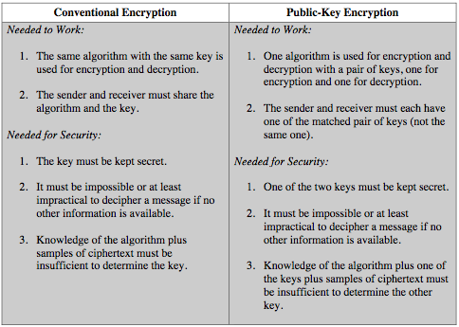
Symmetric vs Public-Key
Notes:
Stallings Table 9.2 summarizes some of the important aspects of symmetric and public-key encryption. To discriminate between the two, we refer to the key used in symmetric encryption as a secret key. The two keys used for asymmetric encryption are referred to as the public key and the private key. Invariably, the private key is kept secret, but it is referred to as a private key rather than a secret key to avoid confusion with symmetric encryption.

Slide 7

Public-Key Cryptosystems

Slide 8
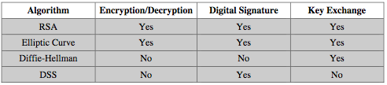
Public-Key Applications
can classify uses into 3 categories:
  encryption/decryption (provide secrecy)
  digital signatures (provide authentication)
  key exchange (of session keys)
some algorithms are suitable for all uses, others are specific to one

Slide 9
RSA
by Rivest, Shamir & Adleman of MIT in 1977
best known & widely used public-key scheme
based on exponentiation in a finite (Galois) field over integers modulo a prime
  nb. exponentiation takes O((log n)³) operations (easy)
uses large integers (eg. 1024 bits)
security due to cost of factoring large numbers
  nb. factorization takes O(e ^{log n log log n}) operations (hard)

Slide 10
RSA Key Setup
each user generates a public/private key pair by:
selecting two large primes at random : p, q
computing their system modulus N=p.q
  note ø(N)=(p-1)(q-1)
selecting at random the encryption key e
    where 1<e<ø(N), gcd(e,ø(N))=1
solve following equation to find decryption key d
  e.d=1 mod ø(N) and 0≤d≤N
publish their public encryption key: KU={e,N}
keep secret private decryption key: KR={d,p,q}

Slide 11
RSA Use
to encrypt a message M the sender:
  obtains public key of recipient KU={e,N}
  computes: C=Me mod N, where 0≤M<N
to decrypt the ciphertext C the owner:
  uses their private key KR={d,p,q}
  computes: M=C^{d} mod N
note that the message M must be smaller than the modulus N (block if needed)

Slide 12
Prime Numbers
prime numbers only have divisors of 1 and self
  they cannot be written as a product of other numbers
  note: 1 is prime, but is generally not of interest
eg. 2,3,5,7 are prime, 4,6,8,9,10 are not
prime numbers are central to number theory
list of prime number less than 200 is:
  2 3 5 7 11 13 17 19 23 29 31 37 41 43 47 53 59 61 67 71 73 79 83 89 97 101 103 107 109 113 127 131 137 139 149 151 157 163 167 173 179 181 191 193 197 199

Slide 13

Prime Factorisation
to factor a number n is to write it as a product of other numbers: n=a × b × c
note that factoring a number is relatively hard compared to multiplying the factors together to generate the number
the prime factorisation of a number n is when its written as a product of primes
  eg. 91=7×13 ; 3600=2⁴×3²×5²

Slide 14
Relatively Prime Numbers & GCD
two numbers a, b are relatively prime if have no common divisors apart from 1
  eg. 8 & 15 are relatively prime since factors of 8 are 1,2,4,8 and of 15 are 1,3,5,15 and 1 is the only common factor
conversely can determine the greatest common divisor by comparing their prime factorizations and using least powers
  eg. 300=2¹×3¹×5² 18=2¹×3² hence GCD(18,300)=2¹×3¹×5⁰=6

Slide 15
RSA Example
Select primes: p=17 & q=11
Compute n = pq =17×11=187
Compute ø(n)=(p–1)(q-1)=16×10=160
Select e : gcd(e,160)=1; choose e=7
Determine d: de=1 mod 160 and d < 160 Value is d=23 since 23×7=161= (1×160)+1
Publish public key KU={7,187}
Keep secret private key KR={23,17,11}
Notes:
Here walk through example using “trivial” sized numbers.
Selecting primes requires the use of primality tests.
Finding d as inverse of e mod ø(n) requires use of Inverse algorithm (see Ch4)

Slide 16
RSA Example cont
sample RSA encryption/decryption is:
given message M = 88 (nb. 88<187)
encryption:
  C = 88⁷ mod 187 = 11
decryption:
  M = 11²³ mod 187 = 88
Notes:
Rather than having to laborious repeatedly multiply, can use the "square and multiply" algorithm with modulo reductions to implement all exponentiations quickly and efficiently (see next).

Slide 17
RSA Example cont
sample RSA encryption/decryption is:
given message M = 88 (nb. 88<187)
encryption:
  C = 88⁷ mod 187 = 11
decryption:
  M = 11²³ mod 187 = 88

Slide 18
Using Modular arithmetic :
88⁷ mod 187
Binary equivalent of 7 = 0111
88¹ mod 187 = 88
88² mod 187 = 7744 mod 187 = 77
88⁴ mod 187 = 77² mod 187 = 132
88⁷ mod 187 = (88 x 77 x 132) mod 187 = 11

Slide 19
Using Modular arithmetic :
11²³ mod 187
Binary equivalent of 23 = 10111
11¹ mod 187 = 11
11² mod 187 = 121
11⁴ mod 187 = 121² mod 187 = 55
11⁸ mod 187 = 55² mod 187 = 33
11¹⁶ mod 187 = 33² mod 187 = 154
11²³ mod 187= (11x121x44x154)mod 187 = 88

Slide 20
Exponentiation
can use the Square and Multiply Algorithm
a fast, efficient algorithm for exponentiation
concept is based on repeatedly squaring base
and multiplying in the ones that are needed to compute the result
look at binary representation of exponent
only takes O(log₂ n) multiples for number n
  eg. 7⁵ = 7⁴.7¹ = 3.7 = 10 mod 11
  eg. 3¹²⁹ = 3¹²⁸.3¹ = 5.3 = 4 mod 11

Slide 21
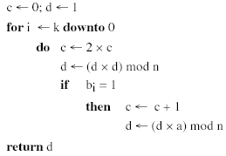
Exponentiation

Slide 22
Assignments
Perform encryption and decryption using RSA algorithm, as in Figure 1, for the following:
  p = 3; q = 11, e = 7; M = 5
  p = 5; q = 11, e = 3; M = 9
In a public-key system using RSA, you intercept the ciphertext C = 10 sent to a user whose public key is e = 5, n = 35. What is the plaintext M?
Encryption
Decryption
Ciphertext
Plaintext
7
11
23
Plaintext
88
88
mod
187
=
11
11
mod
187
=
88
88
KU
=
7
,
187
KR
=
23
,
187
Figure
1
.
Example of RSA Algorithm

Slide 23
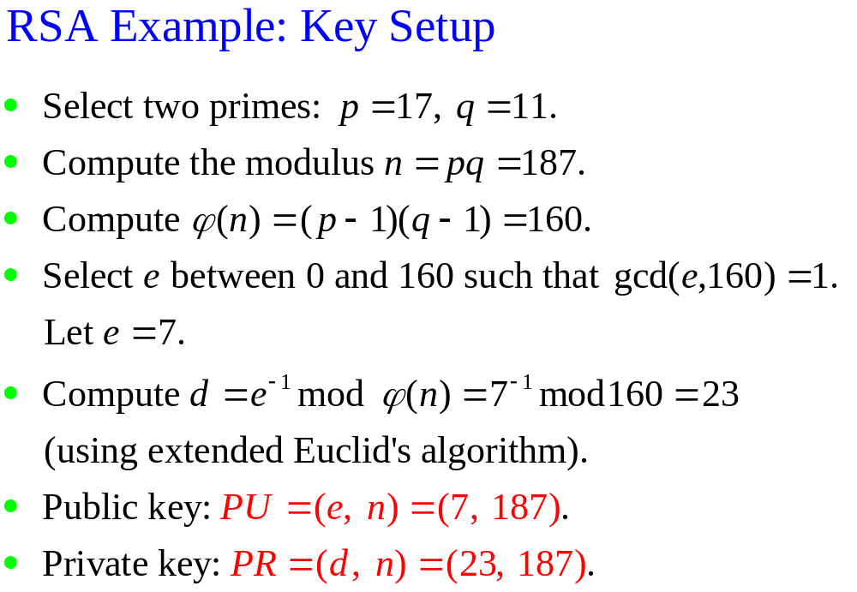

Slide 24
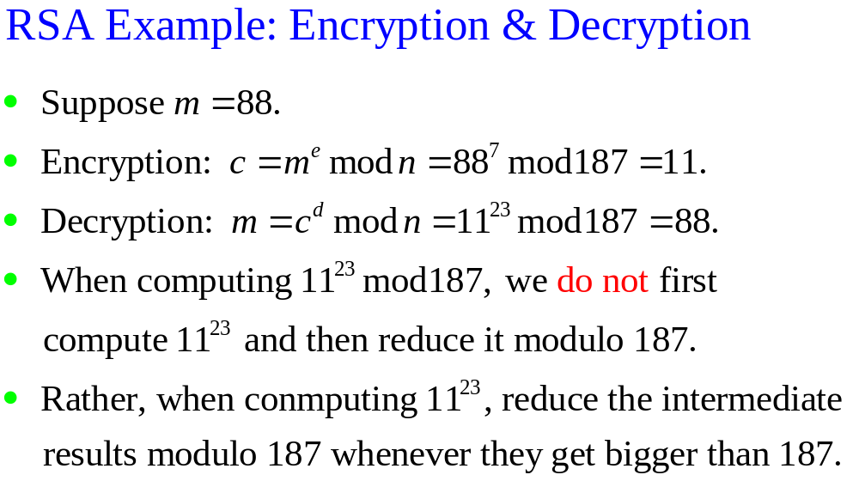

Slide 25
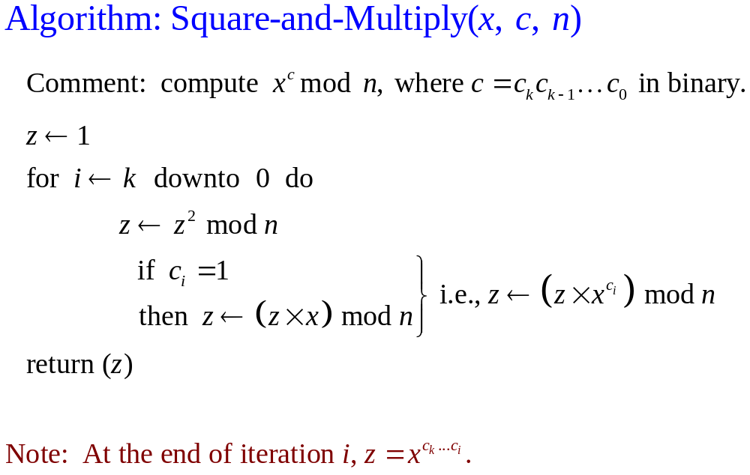

Slide 26
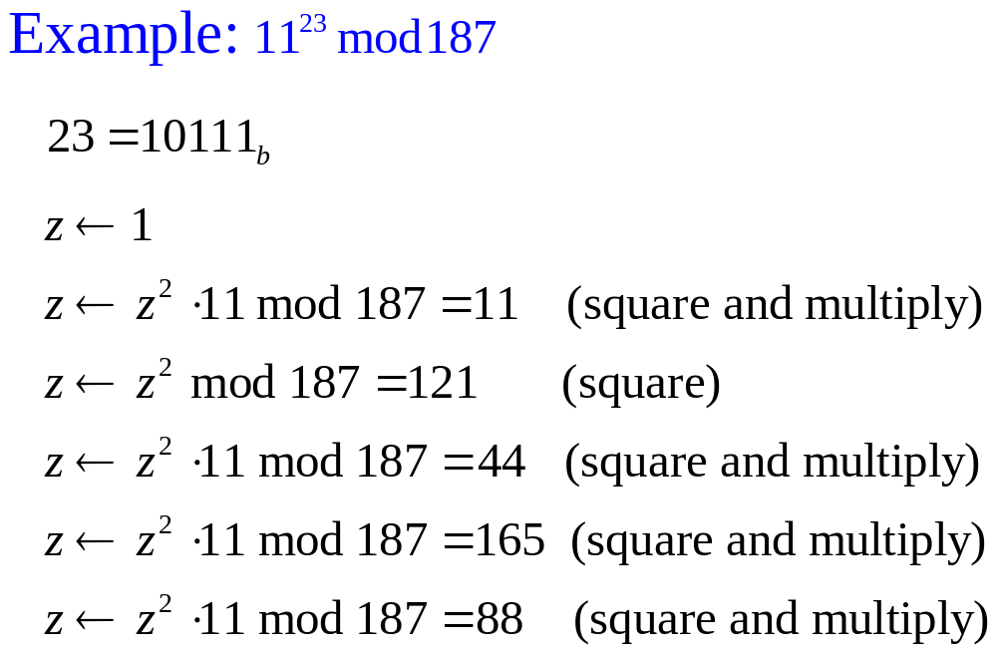

Slide 27
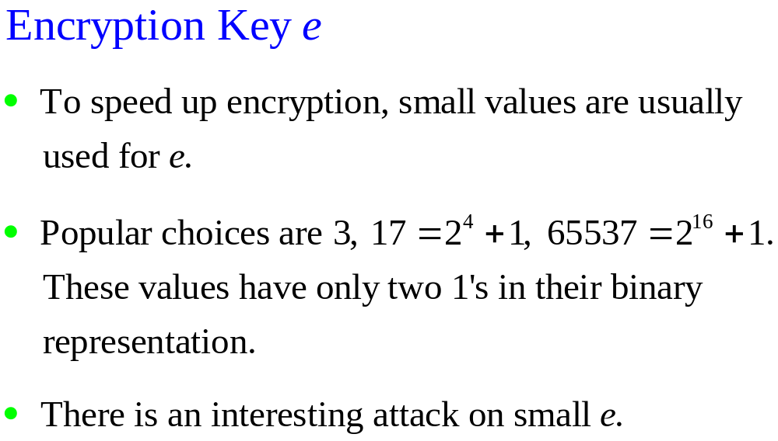

Slide 28
RSA Key Generation
users of RSA must:
  determine two primes at random - p, q
  select either e or d and compute the other
primes p,q must not be easily derived from modulus N=p.q
  means must be sufficiently large
  typically guess and use probabilistic test
exponents e, d are inverses, so use Inverse algorithm to compute the other

Slide 29
RSA Security
three approaches to attacking RSA:
  brute force key search (infeasible given size of numbers)
  mathematical attacks (based on difficulty of computing ø(N), by factoring modulus N)
  timing attacks (on running of decryption)

Slide 30
Factoring Problem
mathematical approach takes 3 forms:
  factor N=p.q, hence find ø(N) and then d
  determine ø(N) directly and find d
  find d directly
currently believe all equivalent to factoring
  have seen slow improvements over the years
    as of Aug-99 best is 130 decimal digits (512) bit with GNFS
  biggest improvement comes from improved algorithm
    cf “Quadratic Sieve” to “Generalized Number Field Sieve”
  barring dramatic breakthrough 1024+ bit RSA secure
    ensure p, q of similar size and matching other constraints

Slide 31
Timing Attacks
developed in mid-1990’s
exploit timing variations in operations
  eg. multiplying by small vs large number
  or IF's varying which instructions executed
infer operand size based on time taken
RSA exploits time taken in exponentiation
countermeasures
  use constant exponentiation time
  add random delays
  blind values used in calculations

Slide 32
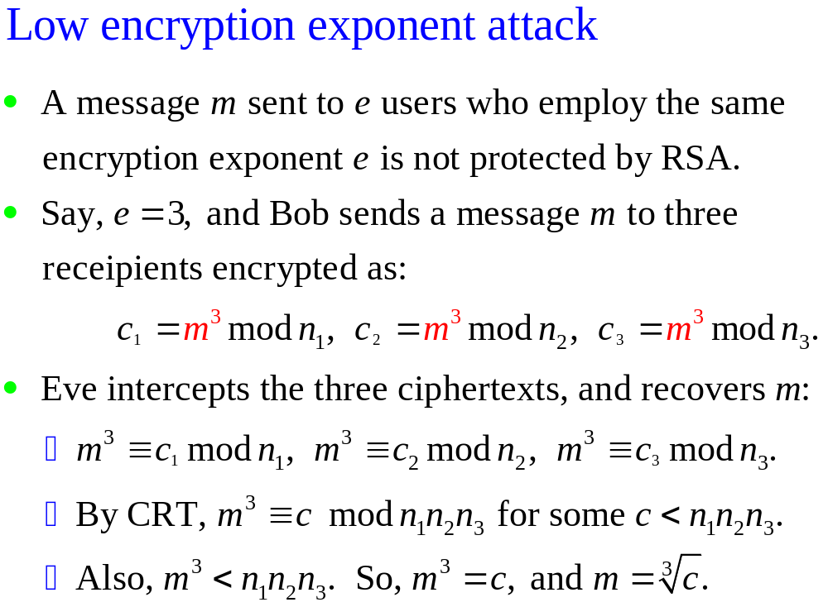

Slide 33
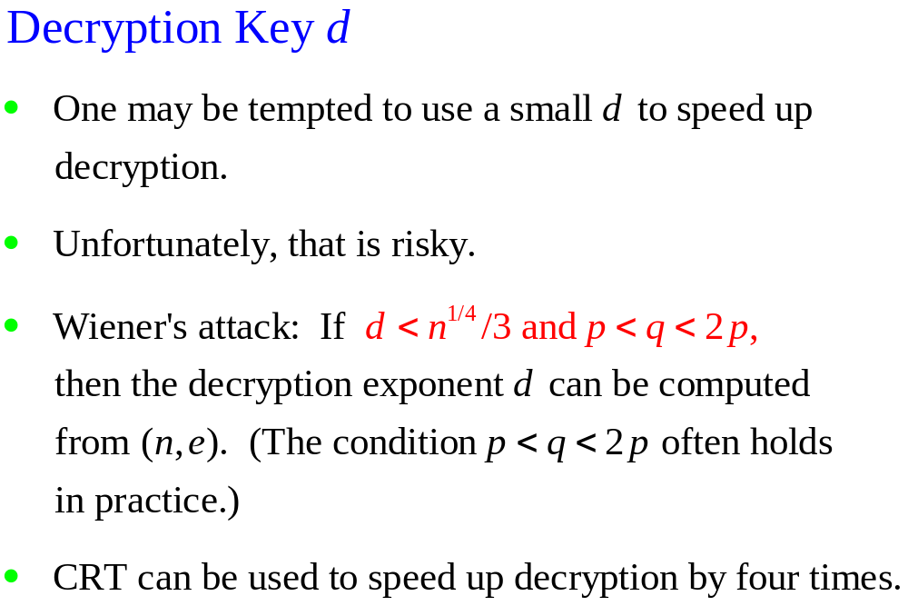

Slide 34
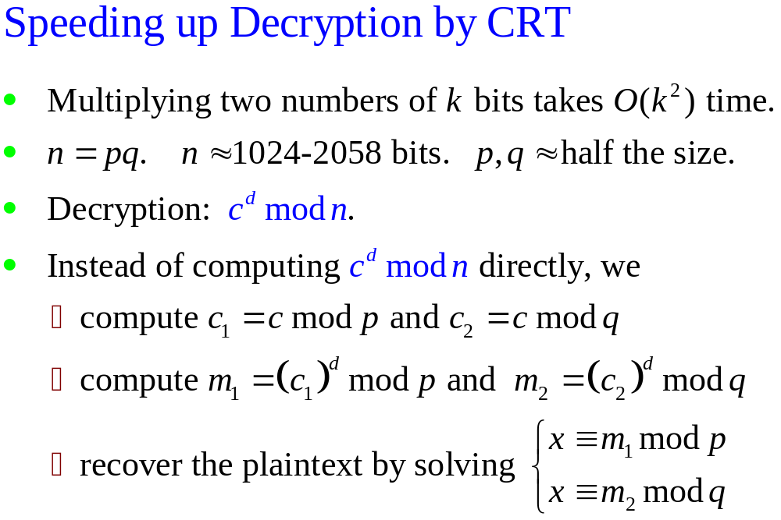

Slide 35
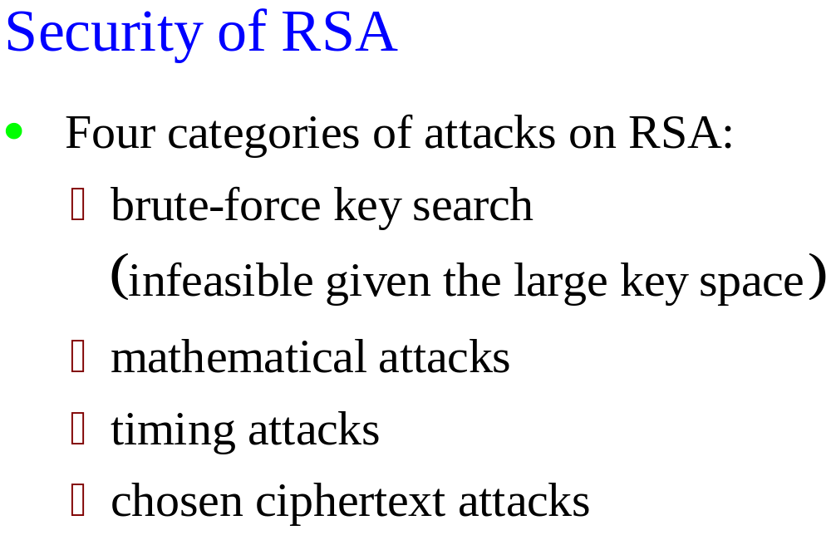

Slide 36
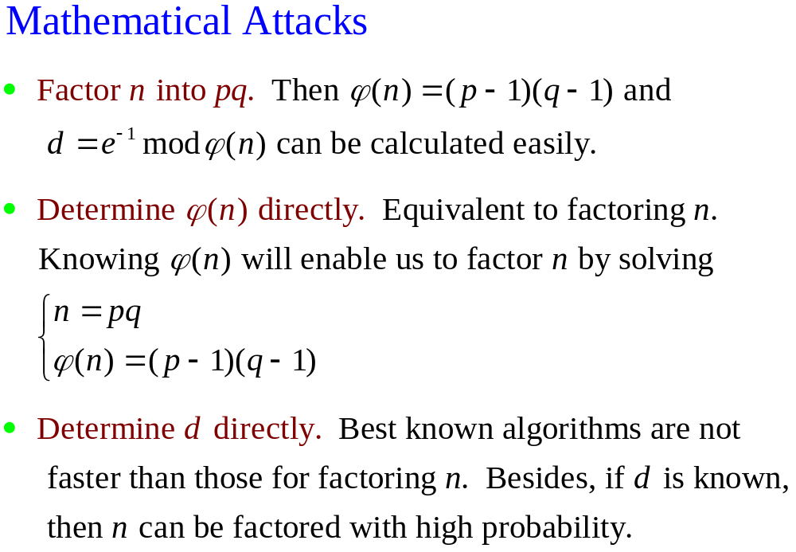

Slide 37
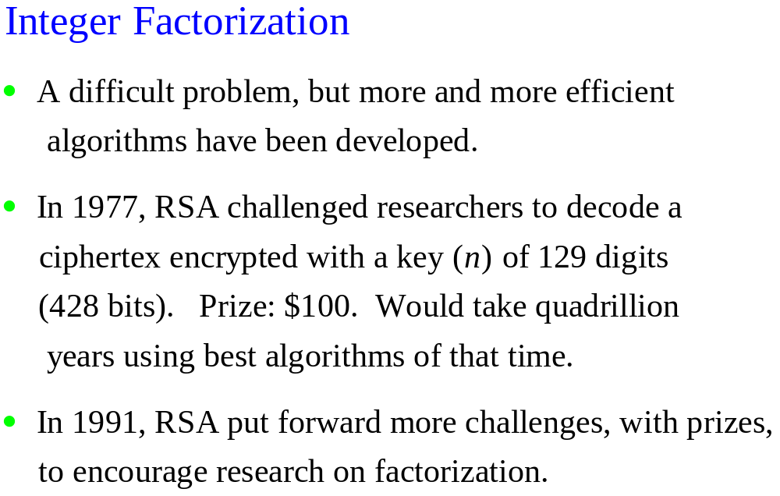

Slide 38
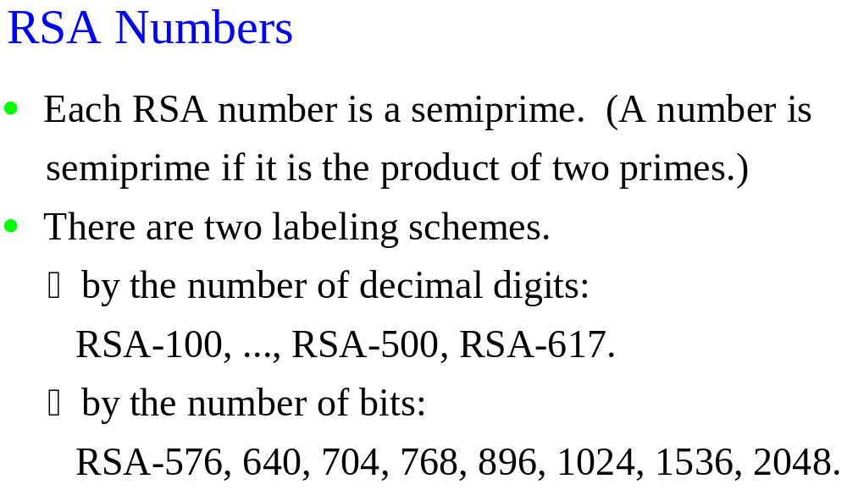

Slide 39
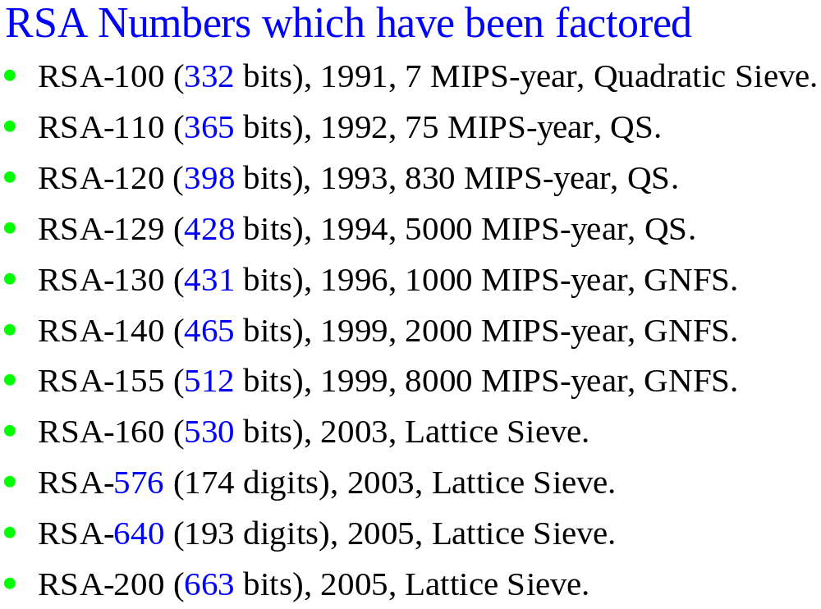

Slide 40
RSA-200 = 27,997,833,911,221,327,870,829,467,638,
722,601,621,070,446,786,955,428,537,560,
009,929,326,128,400,107,609,345,671,052,
955,360,856,061,822,351,910,951,365,788,
637,105,954,482,006,576,775,098,580,557,
613,579,098,734,950,144,178,863,178,946,
295,187,237,869,221,823,983.

Slide 41
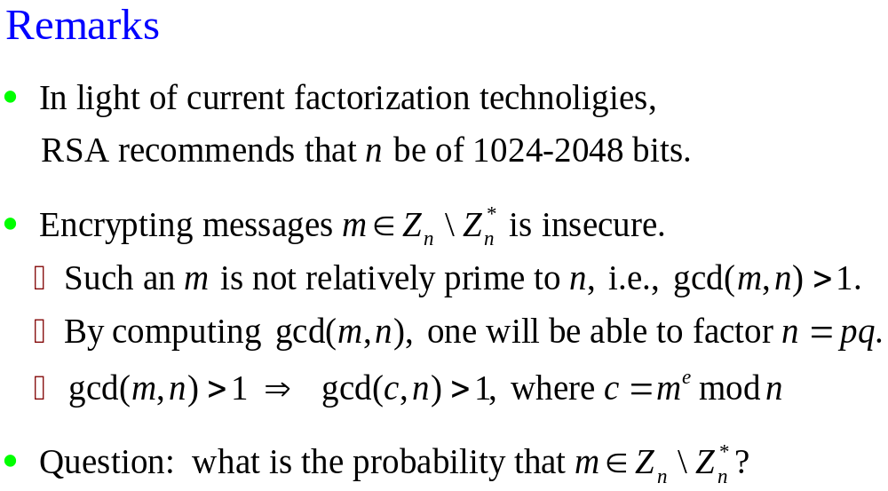

Slide 42
